Slide 1
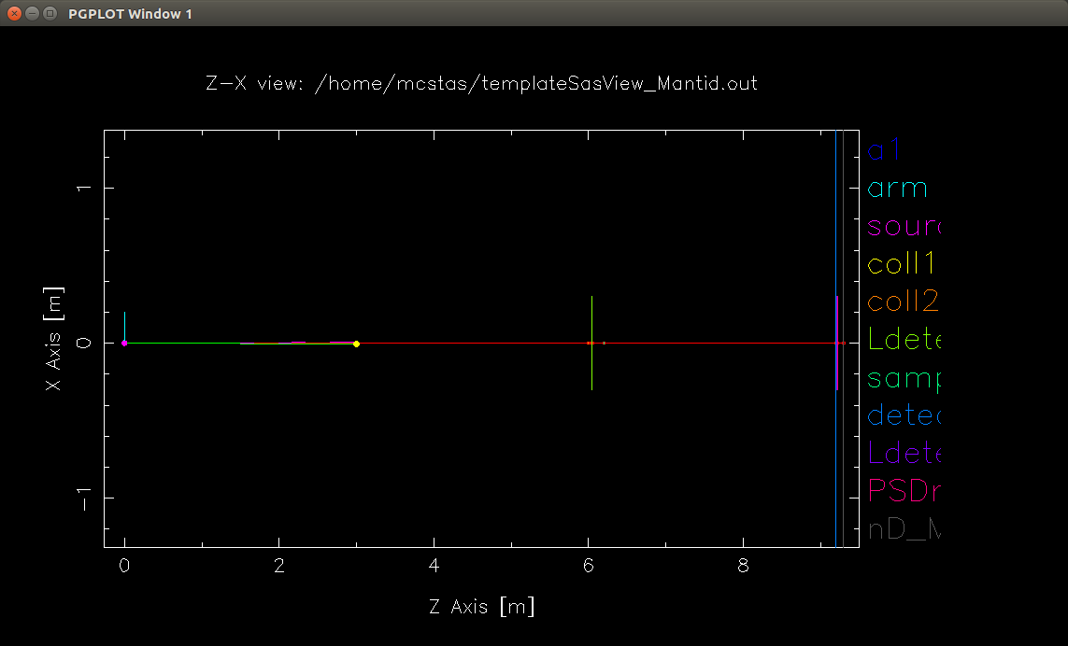
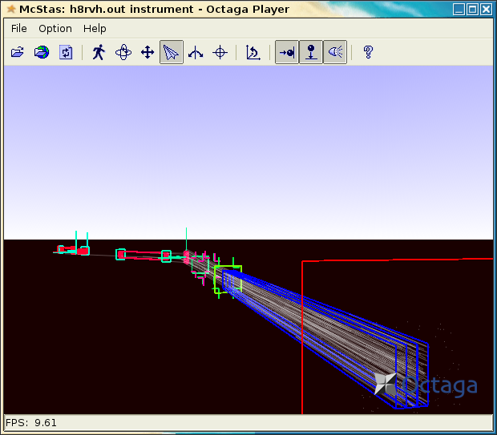
The McStas Raytracing Toolkit for Simulating Neutron Scattering Instruments and Experiments

Slide 2

Monte Carlo Simulation of Triple Axis Spectrometers
Developed at/supported by DTU Physics, ILL, PSI, Uni CPH, ESS DMSC.
Freely available software. Licensed under GNU GPL v2.
Flexible, general simulation utility for neutron scattering experiments.
Allows virtual instruments to be built on a component by component basis.
Used for instrumentation, planning, construction, virtual experiments, data analysis and teaching.
Experimental data can be output to Nexus format (normally HDF5)

Slide 3
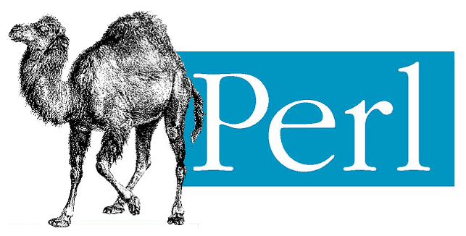
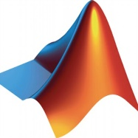
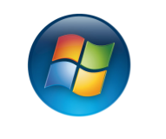
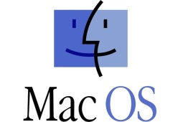
System Requirements and Supported Platforms
A C Compiler (gcc/icc recommended)
Perl and Perl-Tk
Matlab OR (pgplot+pgperl+PDL) OR Gnuplot
Linux, Windows and MacOS. (Instructions on website)

Slide 4
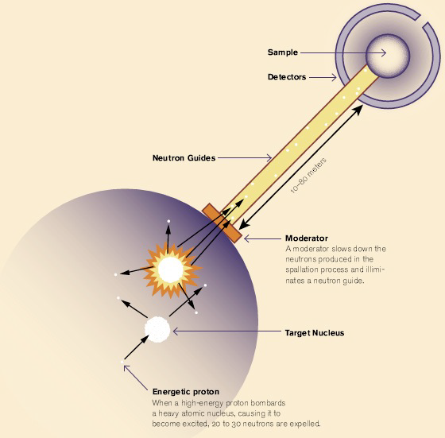
Supported Components
Moderators
Neutron Guides
Collimators & Slits
Choppers
Samples
Detectors (Monitors)
And More

Slide 5
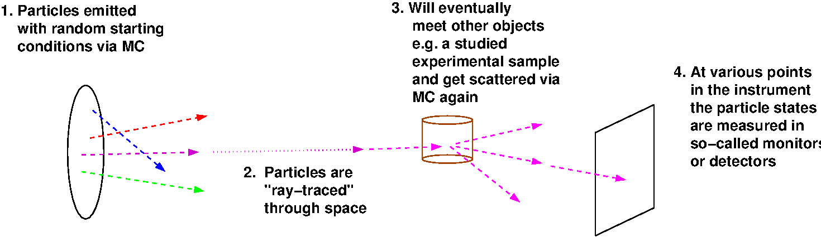
How it works (Simple)

Slide 6
Brief Note on McStas Design/Architecture
McStas is based on a meta-language specifically designed for neutron scattering instruments.
McStas compiles this metalanguage into ISO-C programs.
There are three levels of source code:
  Instrument File (*.instr) - input
  Component Files (*.comp) - input
  ANSI c code (*.c) - output

Slide 7
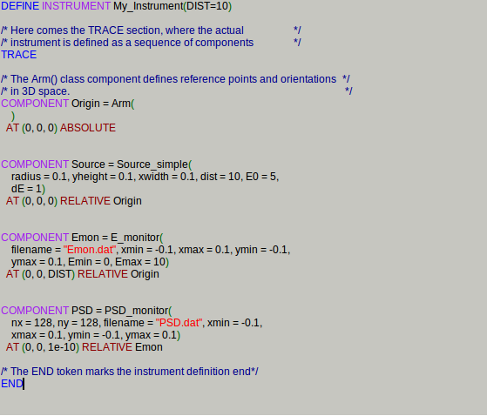
Defining an Instrument
Component Manual - http://www.mcstas.org/documentation/manual/mcstas-2.3-components.pdf
Component Descriptions (and source) - http://www.mcstas.org/download/components/

Slide 8
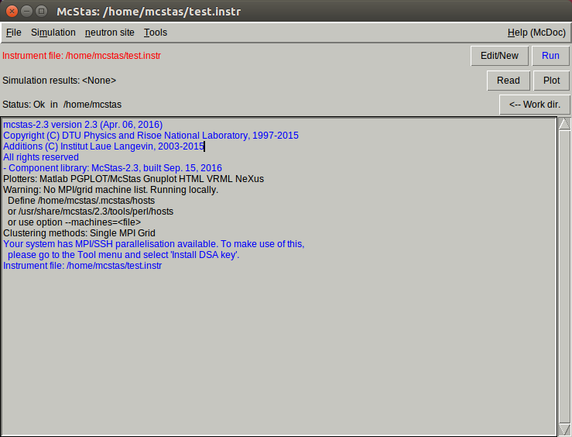
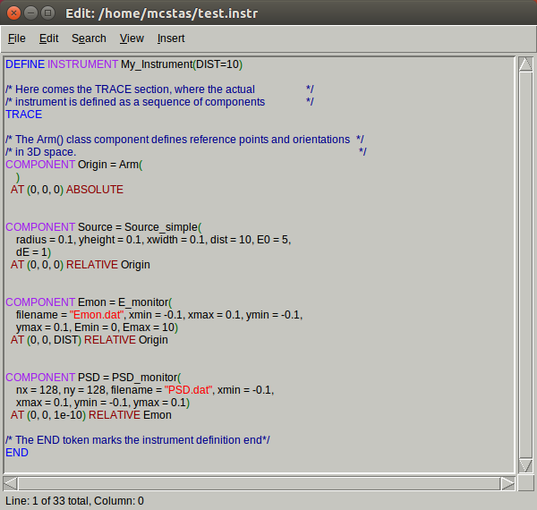
McGUI (Creating/Editing Instruments)

Slide 9
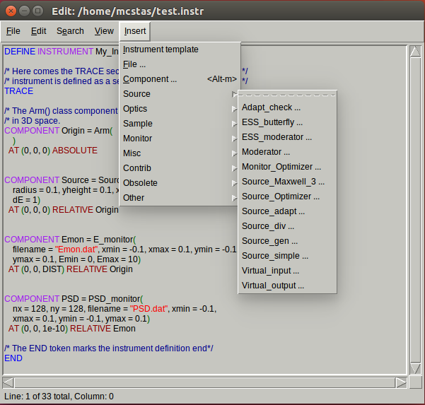
McGUI (Selecting Components)

Slide 10
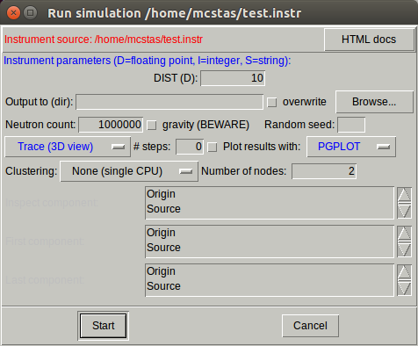
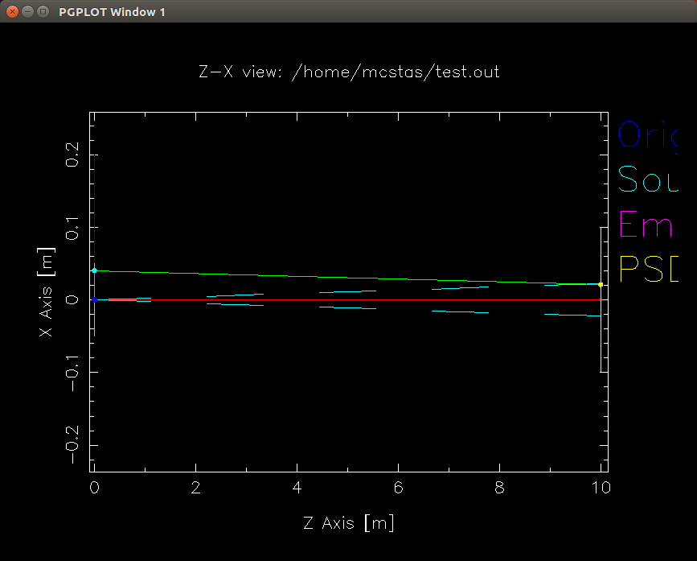
McGUI (Tracing by Hand)

Slide 11
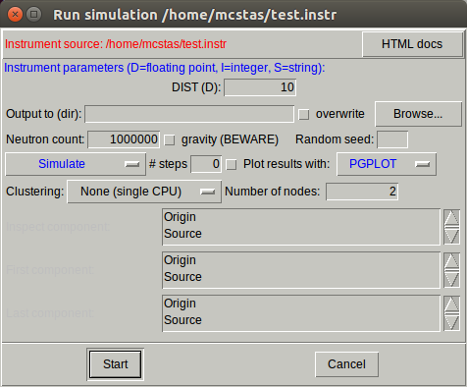
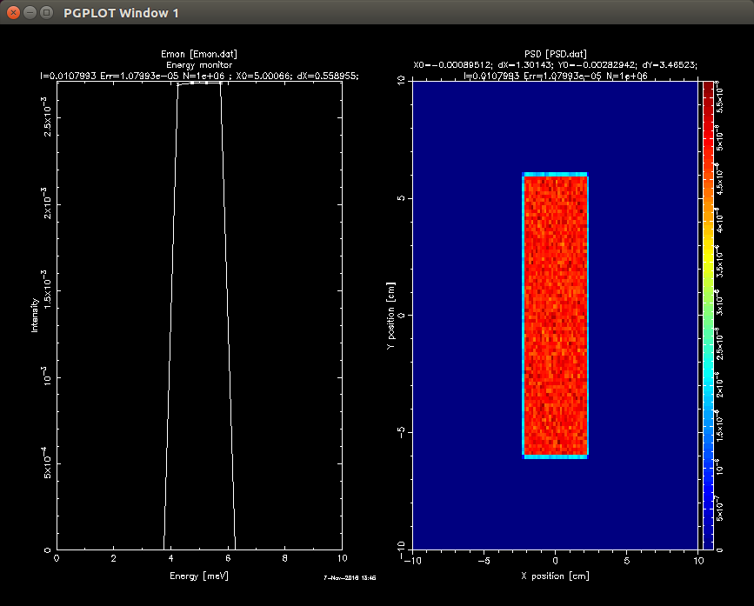
McGUI (Running the simulation)

Slide 12

Extras
Interoperability with Mantid. Components are written as Mantid components into an IDF.
IDF embedded in Nexus output and written as an xml file using mcdisplay.
Requires special naming conventions.
  sourceMantid
  sampleMantid
  nd_Monitor_n
Uses OFF file types for more complex geometries.

Slide 13
Questions?

